Slide 1
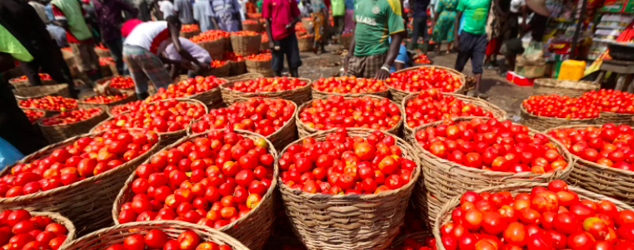

Module 8
Market Testing
Location, Date - The Next Economy Incubation
Notes:
Photo by Omar Flores on Unsplash

Slide 2
How to use this document
This Powerpoint is a living document. It is yours to own!
You can delete slides or add slides where you think this is necessary to achieve the lesson objectives
Tips are added in the notes or in the slide highlighted
You can add personal examples where you see fit
You can adapt links to external resources according to your students’ needs
Good luck and have fun!

Slide 3

WARM UP
Photo by Daniel Öberg
Notes:
Add description and instructions.

Slide 4

RECAP
PREPARE activities
Photo by Elodie Oudot
Notes:
Previous homework?

Slide 5


MODULE 8
Market Testing
OVERALL OUTCOME
LEARNING OBJECTIVES
To be able to advance your concept and prototype by testing it in the market
Learn about why we test
Lean Canvas learning methods
Learn how to measure, analyse your data and implement improvements
Learn how to implement proper planning methods

Slide 6
MODULE 8
Market Testing
RECAP
PREPARE activities
GROUP DISCUSSION
Why is it important to test in the market?
PRESENTATION
Why / How / What
CREATE TESTING STRATEGY
Key Performance Indicators
Benchmarking
What is success?
HOMEWORK
WRAP UP and
PREPARE
xx minutes xx minutes xx minutes xx minutes xx minutes

Slide 7

GROUP DISCUSSION
Why do we test in the market?
Photo by

Slide 8

Market Testing
What is it?
Market testing is a way to test the waters to see how well a product, service, or offering will perform…or not.
Get to know the value of your product
Understand where there is or isn’t added value
Gauge the interest of the market
Gauge the usability of your product
Gauge your customer’s interest in the product
Gauge the messaging of your product (how to market it?)
Unsplash - Júnior Ferreira

Slide 9
Market Testing
Why?
(Relatively) cheap way of getting feedback on a prototype
Provides information that you can use to make key decisions
Getting to know your customer in an informal way
Creating your first customer base

Slide 10














Market Testing - Lean Canvas
Routine
An idea becomes a design
Money is needed to start production
Start production in batches
Big inventory
Marketing campaign & start of sales
First clients start buying the product
Lean
Study the problem
Verify the solution
Learn – Build – Measure
Testers become potential customers
Sales by product improvements
Experiment

Slide 11
Market Testing - Lean Canvas
Routine
An idea becomes a design
Money is needed to start production
Start production in batches
Big inventory
Marketing campaign & start of sales
First clients start buying the product
Lean
Study the problem
Verify the solution
Learn – Build – Measure
Testers become potential customers
Sales by product improvements
Experiment

Slide 12






Market Testing - Measure the right results
Ideas
Learn
Improve
Data
Product
Measure

Slide 13

Market Testing - What’s the Plan?
Ideas
Ideas
Learn
Learn
Improve
Improve
Data
Data
Product
Product
Measure
Measure

Slide 14
Market Testing - Measure the right results
Relevant
Measure as much data as possible, but report only relevant data
Actionable
Create a clear set of actionable data (i.e. what do my customers think of the price?)
Measure
Responsibility
Make someone responsible for the data collection and analysis
Predicting
Focus on predicting metrics, that way you prove or disprove a hypothesis (i.e. my pricing is too high)
TIP
Improving results starts with creating visibility and measuring metrics based on the indicator you chose

Slide 15

Market Testing - What’s the Plan?
Methods of testing & data collection
    Interviews
    Surveys
    Online surveys
    Focus groups
    A/B testing
    …..

Slide 16
Market Testing - What’s the Plan?
Your Key Performance Indicators (KPI’s) determine when your test is a success
→ what do you want to test (pick and choose, don’t test it all)
→ how many people do you need to test with to be indicative of the market?
    Xx people interviewed
    Xx people used your product
    Xx number of people reached
    ….

Slide 17

Market Testing - example
Jojo Juice
JoJo would like to test a new flavour of juice called ‘Goiji Berry delight - the super food you didn’t know you were waiting for’.
The Juice is more expensive than the other juices due to more expensive ingredients.
TESTING:
    Would customers pay 150% the price of a normal juice?
    Do customers enjoy the taste or is it too bitter?

Slide 18
Market Testing
TESTING:
    Would customers pay 150% the price of a normal juice?
    Do customers enjoy the taste or is it too bitter 1 = sweet & 10 is too bitter?
KPI’s
50 customers to taste the new juice and ask them to pay what they would think it’s worth
50 customers to taste the juice and ask if they are happy with the 150% mark-up price
50 customers to taste the juice and rate the juice on bitterness on a scale from 1-10
50 customers to rate the likelihood that they would recommend the juice to another customer

Slide 19
Market Testing - What’s the Plan?
Exercise:
Your Key Performance Indicators (KPI’s) determine when your test is a success
→ what do you want to test (pick and choose, don’t test it all)
→ how many people do you need to test with to be indicative of the market?
Fill out your test:
    Xx people interviewed
    Xx people used your product
    Xx number of people reached
    ….

Slide 20
Market Testing - Learn from the results
Ideas
Learn
Improve
Data
Product
Measure

Slide 21
Market Testing - Learn from the results
Based on data
Use your data to be objective with learnings and decisions
Experiments
Learn with small experiments: prove that your data changes, instead of assuming it will.
Accumulated
Build on your learnings, you’ll remember them once the same problem occurs.
Learn
Biased
Be aware you and your team are biased during analysing data; prove that you’re right
TIP!
Document all learnings well, so you can find and review them once the same issue occurs

Slide 22
Market Testing - example
Jojo Juice
TESTING:
    Would they pay 150% the price of a normal juice?
    Do they enjoy the taste or is it too bitter?
HYPOTHESIS:
Customers think the juice is too expensive
Customers think the juice is too bitter

Slide 23
Market Testing
KPI’s | Test outcome
50 customers to taste the new juice and ask them to pay what they would think it’s worth | 20 customers paid half of what they paid for a normal juice 20 customers paid double the normal price 10 customers paid normal price
50 customers to taste the juice and ask the 150% mark-up price | 20 customers said it was too expensive 30 customers loved the juice and said the pricing was just right
50 customers to taste the juice and rate the juice on a scale from 1-10 | 10 customers rated the juice an 8 15 customers rated the juice a 6 25 customers rated the juice a 7,5 AVERAGE: 7,15
50 customers to rate the likelihood that they would recommend the juice to another customer | 40 customers would recommend the juice to another customer 10 customers would not recommend the juice to another customer

Slide 24
Market Testing
Exercise: answer below questions
What can Jojo deduct from the outcomes of her testing?
What can Jojo improve on her product?

Slide 25
Market Testing - ideation
Ideas
Learn
Improve
Data
Product
Measure

Slide 26
Market Testing - Ideation
Exercise:
Make a list of all the improvements that Jojo can make on her product on the basis of her market testing.
Plot these ideas on the following graph based on impact (high-low change that it created) and feasibility (easy-hard)

Slide 27
Market Testing - Ideation
High
Impact
Low
Hard
Easy
Feasibility

Slide 28

Market Testing - Ideation
High
Creating a slogan
Add more sugar
Develop new juice
Pricing
125%
Impact
Low
Hard
Easy
Feasibility

Slide 29
Market Testing - Ideation
High
Creating a slogan
WOW ideas
Add more sugar
Develop new juice
Pricing
125%
Impact
Low
Hard
Easy
Feasibility

Slide 30
Market Testing - Measure the right results
Ideas
Learn
Improve
Data
Product
Measure

Slide 31
Market Testing - Create your improvements
Rank
Rank your improvements from highest to lowest impact and feasibility (see previous slides for ranking tool)
Plan
Plan product improvements and decide what you’d like to test (see next slides for planning tool)
Improve
Improve your product on the items that you ranked highest on impact and feasibility.
Improve
Plan Implementation
Plan implementation of improvements into your products with your team and start testing again!
TIP!
Document all changes so you know what you improved and what you want test next

Slide 32
Planning
Why does planning work?
Understanding who does what, when
Creates ownership with tasks and responsibilities for the team
Looking ahead and understanding what the next day, week, year looks like
Make informed decisions on feasibility

Slide 33
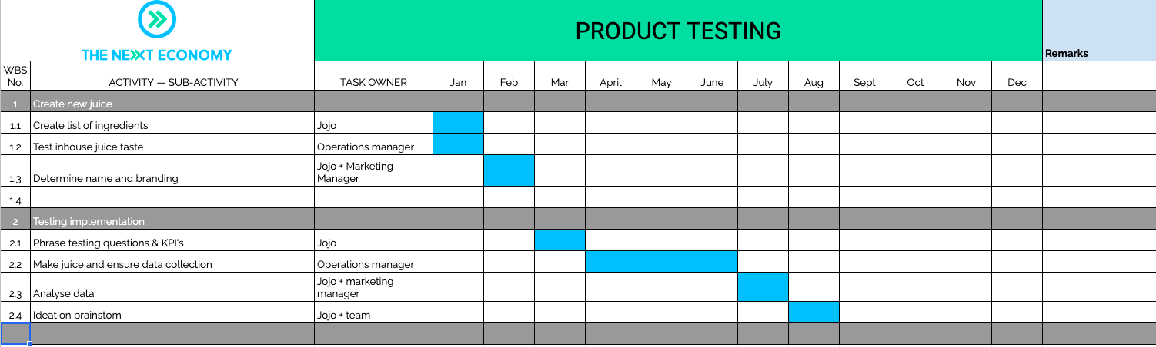
Planning - GANTT Chart

Slide 34

HOMEWORK
WRAP UP this module
PREPARE for next module
Photo by
Notes:
Homework = to create your own Gantt chart for your testing.

