Slide 1


Financial Basics
MODULE 5
Getting comfortable with finance

Slide 2
Financial Basics
MODULE 5
In this lesson you will learn the basics on start-up finance and receive tools to set up your own financial administration.
At the end of this lesson, you should feel more comfortable to talk about finance and to record the financial basics of your business
Develop a basic understanding of financial concepts;
Know how & why to set up a financial administration;
Understand the 3 financial statements of a business.

Slide 3
Session Overview
MODULE 5
5 Min
BREAK
10 Min
BREAK
5 Min
BREAK
WARM UP
Taking steps
PREPARE
Lingo Quiz
GROUP DISCUSSION
Are you in control of your finance?
PRESENTATION
& exercises
Financial administration The who, what, when, where
PRESENTATION
Financial Statements
GROUP EXERCISE
From reality to paper
HOMEWORK
Your own financial statements
45 min
80 min
60 min
40 min

Slide 4
Start-up Finance
3 Modules on finance!
Get up to speed on:
Financial administration > Module 5
Financial models > Module 6
Financial planning > Module 11
Investments > Module 11
Gain the confidence and knowledge to talk about the finances of your startup!

Slide 5

ENERGIZER
Finance Lingo

Slide 6
Quiz!
What is the difference between turnover and revenues?
  Turnover is the total amount of sales a business generates, revenues are the profit a business makes after subtracting costs.
  There is no difference.
Are both statements below about interest rates correct?
An interest rate is how much interest is paid by borrowers for the money that they borrow. It is usually a percentage of the sum borrowed. So, a simple 10% interest means that if one borrows $200, one pays back $220.
A loan that is considered low risk by the lender will have a higher interest rate. A loan that is considered high risk will have a lower interest rate.
Both are correct
Only 1 statement is correct.
3. In general, is Venture Capital an equity or a debt investment?
  Equity
  Debt

Slide 7
Quiz!
4. A balance sheet is the financial statement of a business which includes assets, liabilities and equity at a point in time. True or false: for the balance sheet to be correct, liabilities & assets should be equal to each other.
  True
  False
5. Which of the following statements about the concept of profit is incorrect?
  Profit is calculated as total revenue minus total expenses
  Profits earned are reinvested back into the business, and are not funneled back to business owners.
6. Fixed costs are costs that do not change with varying output. Which of the following choices shows examples of fixed costs?
  Commision, raw material inputs.
  Rental payments, insurance, machinery.

Slide 8

GROUP DISCUSSION
Are you in control of your finance?

Slide 9
GROUP DISCUSSION
What is your average monthly turnover?
Do you know the margins on your products or services?
Can you name your fixed and variable costs?
Do you have an annual budget?
Do you keep a daily ledger?
ARE YOU IN CONTROL?

Slide 10

PRESENTATION
Financial Administration
From daily ledgers to annual accounts

Slide 11

Financial administration is the sum of processes, people and structures to record and manage the financials of a business.

Slide 12

GROUP DISCUSSION
What is a good financial administration?
What do you need to have?

Slide 13
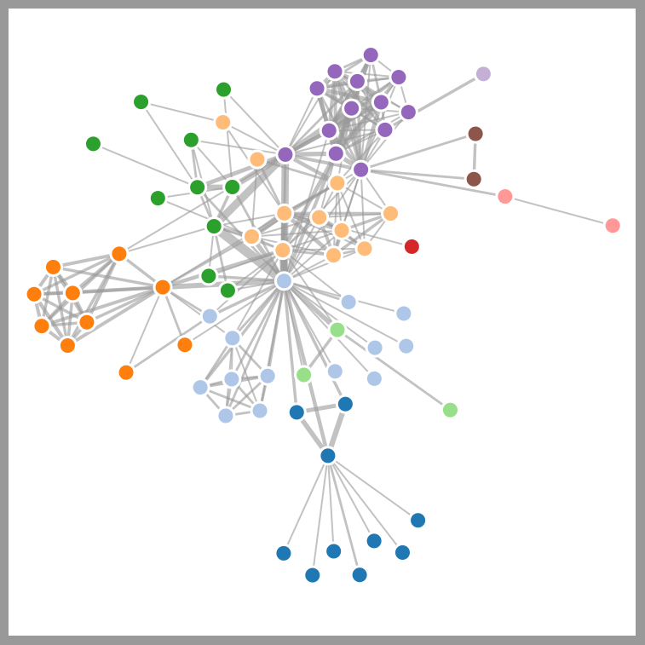
Connecting the dots
INPUTS
ACCOUNTANT
INVOICES
DAILY LEDGER
INVESTMENTS
TAXES
MOBILE MONEY
BUDGET
RENT
MARGIN
CUSTOMERS
SUPPLIERS
CASH
SALARIES
RECEIPTS
Notes:
Good fin administration connects the dots

Slide 14
BRAINSTORM
What are some financial activities and actions?

Slide 15


Slide 16
Who
Many persons have an interest in your business finance OR perform financial actions.
  Can be employees, owners, accountant, government, suppliers, but also family.
Different people need different information.
  Different people have different rights to perform financial actions, like receiving or making payments.
Decide:
Who is a stakeholder in your finances?
Who needs what information?
Who has authority over financial flows (in and out)?
Photo by UX Indonesia on Unsplash

Slide 17
Group Exercise
Joanna has a cafe in downtown Abuja where she sells fruit drinks and cakes: JoJoJuice.
During the week, she is able to manage the cafe by herself, and in the weekend she has 2 employees who help out when it gets busy. Joanna has registered her business, because she wants to get a bank loan in the future and thinks a registration will help.
At home, Joanna lives with her parents, as they are old and rely on her care and support.
Who is a stakeholder to JoJoJuice’s finances? | What information do they need? | What authority do they have over JoJoJuice’s finances?

Slide 18
Individual Exercise
Who are stakeholders to your business’ finances? | What information do they need? | What authority do they have over your finances?

Slide 19
When
Know when money is coming in & out - is this aligned?
Decide:
When which finances are entered into your administration, from daily cash register counts to monthly payments to suppliers.
Photo by UX Indonesia on Unsplash

Slide 20
Group Exercise
Joanna has a cafe in downtown Abuja where she sells fruit drinks and cakes: JoJoJuice.
During the week, she is able to manage the cafe by herself, and in the weekend she has 2 employees who help out when it gets busy. Joanna has registered her business, because she wants to get a bank loan in the future and thinks a registration will help.
At home, Joanna lives with her parents, as they are old and rely on her care and support.
When | What are the financial actions on a [...] basis? | Who is performing these actions?
Daily
Weekly
Monthly
Quarterly
Annual

Slide 21
Individual Exercise
When | What are the financial actions on a [...] basis? | Who is performing these actions?
Daily
Weekly
Monthly
Quarterly
Annual

Slide 22

Raise your hand if….
You have a business bank account
You have both cash and digital finance flows
You use paper invoices
You use digital invoices
You keep your finances on your laptop

Slide 23
Where
Where concerns both physical and digital administration.
Where concerns money (cash or digital) AND administration (invoices, excels, etc.)
FEWER places = BETTER
A.L.W.A.Y.S.
HAVING A BACK-UP = ESSENTIAL
A.L.W.A.Y.S.
Photo by UX Indonesia on Unsplash

Slide 24
Group Exercise
Joanna has a cafe in downtown Abuja where she sells fruit drinks and cakes - JoJoJuice. During the week, she is able to manage the cafe by herself, and in the weekend she has 2 employees who help out when it gets busy. Joanna has registered her business, because she wants to get a bank loan in the future and thinks a registration will help.
At home, Joanna lives with her parents, as they are old and rely on her care and support.
What | Where
Cash | Cash from sales: in the cash register, counted&emptied daily Cash for suppliers and other big expenses: in the safe at the cafe
Digital payments
Daily sales records
Supplier invoices
Annual budget
Cash flow statement
...

Slide 25
Individual exercise
What | Where
Cash
Digital payments
Daily sales records
Supplier invoices
Annual budget
Cash flow statement
...

Slide 26

WHAT
What you collect and record depends on what you need it for:
  Compliance, e.g. (government) reporting
  Forecasting, e.g. future investments
  Analytics, e.g. cost analysis and cyclicality
At a minimum, you will need to set up:
  A budget (future) and actuals (past)
  The 3 financial statements:
Cash Flow
Profit & Loss (a.k.a. Income statement)
Balance Sheet
Let’s dive into the financial statements!
Photo by

Slide 27
Profit & Loss
Cash Flow
Balance Sheet

Slide 28
What are the differences between these statements?
What is recorded in each?
What do you use them for?

Slide 29
Exercise: Connect the Dots
Joanna from JoJoJuice….
Buys a new kitchen appliance
Sells 3 cakes on Tuesday
Receives an order for a juice party next month
Pays her employees
Gets a loan to invest in new furniture
Hires a marketing company for new posters
Profit & Loss
Cash Flow
Balance Sheet

Slide 30

Profit & Loss
Also known as Income statement
Most common financial statement
Shows the income, expenses and resulting profitability of your operations over a selected time period
Can be used to record actuals AND as a forecasting tool (a budget)
Can be used to analyse trends in revenues, expenses, margins and more.
Photo by heylagostechie

Slide 31
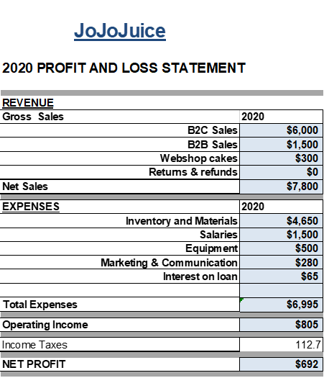
INCOME (aka Revenue aka Turnover)
Can be by type (juice, cakes), by sales channel (B2B, B2C) or another categorization that is useful for you
If you have refunds (e.g. clothing returns) subtract this from your sales.
You will NOT see the income from loans in revenue. Revenue in a P&L has to be generated through business, not through investors.
You count income when the service/product legally changes hands, NOT just when cash changes hands.
  E.g. a business customer pays an advance of $500 for a big party next month. When the party is successful, he pays another $500. The total revenue here ($1000) may only be counted when the party has happened! That is when the service/product is officially delivered.

Slide 32
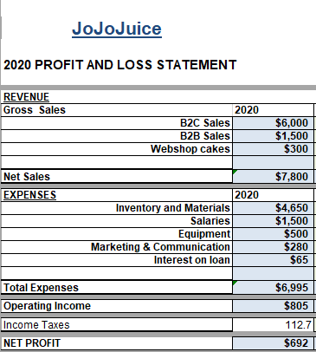
Expenses
Includes fixed expenses (e.g. rent) and variable expenses (e.g. materials)
You DON’T record principal repayments on loans, you DO have to record interest expenses from your loan.
BIG expenses are normally expensed over their lifetime use, not just at once.
E.g. a professional oven that costs $5,000 can be ‘expensed’ over 5 years time, $1,000 per year.
This ‘evens out’ your P&L and avoids big differences year-on-year.

Slide 33
Group Exercise: Connect the Dots
Joanna from JoJoJuice….
Buys a new kitchen appliance of $300
Sells 3 cakes in the cafe on Tuesday for $5 each
Receives an order for a juice party next month for $250, including an advance payment of $150
Pays her employees their salary of $750 in total
Gets a loan to invest in new furniture of $1200
Hires a marketing company for new posters costing $300

Slide 34
Cash Flow Statement
Looks like the P&L, but….
The P&L looks at when a transaction is LEGALLY made, but a cash flow statement looks at when the cash changes hands
P&L looks at ‘regular’ operations and doesn’t show external investment, a cash flow shows the cash from investments.
A cash flow statement shows if you have enough cash coming in to meet your expenses
Photo by heylagostechie

Slide 35
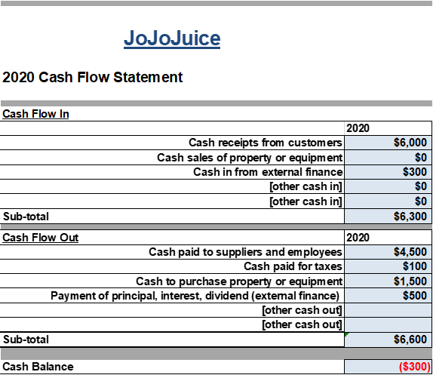
Cash Flows in & out
Look at all sources of cash, this can be from sales of your product, but also if JoJoJuice sells an old oven or takes out a loan.
It’s best practise to make a cash flow forecast per month. That way you can see if you have a cash flow problem coming up.
  E.g. in January, juice sales are historically low, because everyone spent their money in December. However, JoJoJuice’s loan (both interest and principal) are due in January. This might be a cash flow problem.

Slide 36
Group Exercise: Connect the Dots
Joanna from JoJoJuice….
Buys a new kitchen appliance of $300
Sells 3 cakes in the cafe on Tuesday for $5 each
Receives an order for a juice party next month for $250, including an advance payment of $150
Pays her employees their salary of $750 in total
Gets a loan to invest in new furniture of $1200
Hires a marketing company for new posters costing $300

Slide 37
Balance Sheet
Shows the assets and liabilities of a business at a point in time.
Assets refer to the things owned by the business that present value, like cash, property, equipment.
Liabilities refer to the things the companies owes, like salaries, loans, taxes.
What’s left when you deduct your liabilities from assets is the equity
Photo by heylagostechie

Slide 38
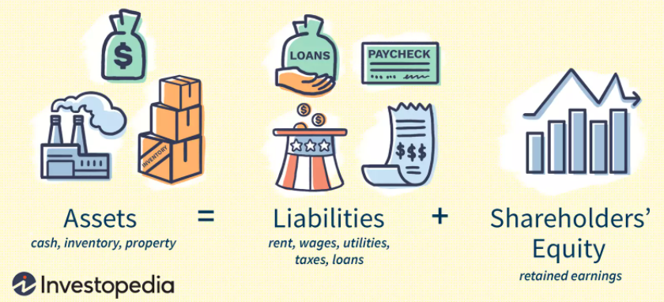

Slide 39
A year of rent paid in advance
Credit card debt to pay inventory
A payment you still have to pay to your supplier
The chairs & tables in your cafe
A bank loan that you need to repay in 2 years time
An industrial oven
Finished products in your warehouse

Slide 40
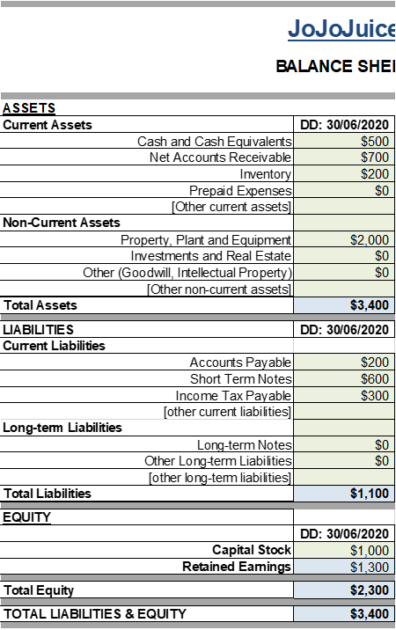
Balance Sheet
Current refers to assets and liabilities that are expected to change in the coming 12 months.
  E.g. the cash that is counted on 30/6/2020 will probably be used in the coming weeks. The amount will be different when we count again in 30/7/2020
  E.g. Salaries are paid monthly on the 30th for the same month. This means that from the 1st until the 29th, the business has a liability on salaries (accounts payable) - they will have to pay these very soon.
Long-term or Non-current assets and liabilities are expected to remain the same for 12+ months.
A balance sheet is the only financial statement that is a snapshot in time.

Slide 41
Group Exercise: Connect the Dots
Joanna from JoJoJuice….
Buys a new kitchen appliance of $300
Sells 3 cakes in the cafe on Tuesday for $5 each
Receives an order for a juice party next month for $250, including an advance payment of $150
Pays her employees their salary of $750 in total
Gets a loan to invest in new furniture of $1200
Hires a marketing company for new posters costing $300

Slide 42

Summary?
Photo by

Slide 43
Summary
Financial administration encompasses A LOT.
It is not just about recording sales and expenses, but also about the big network of people that have different information needs and authorities.
If done properly from the start, it will save a lot of time when you do your taxes or want to talk to external investors
The 3 financial statements are all intertwined, but used to collect different types of information and insights.
You use your financial administration to look at the past (how did I do last year?) and the future (what can I do next year?)

Slide 44
HOMEWORK
Use the templates to make your financial statements
We will use these in the next lesson!
Photo by

